Slide 1
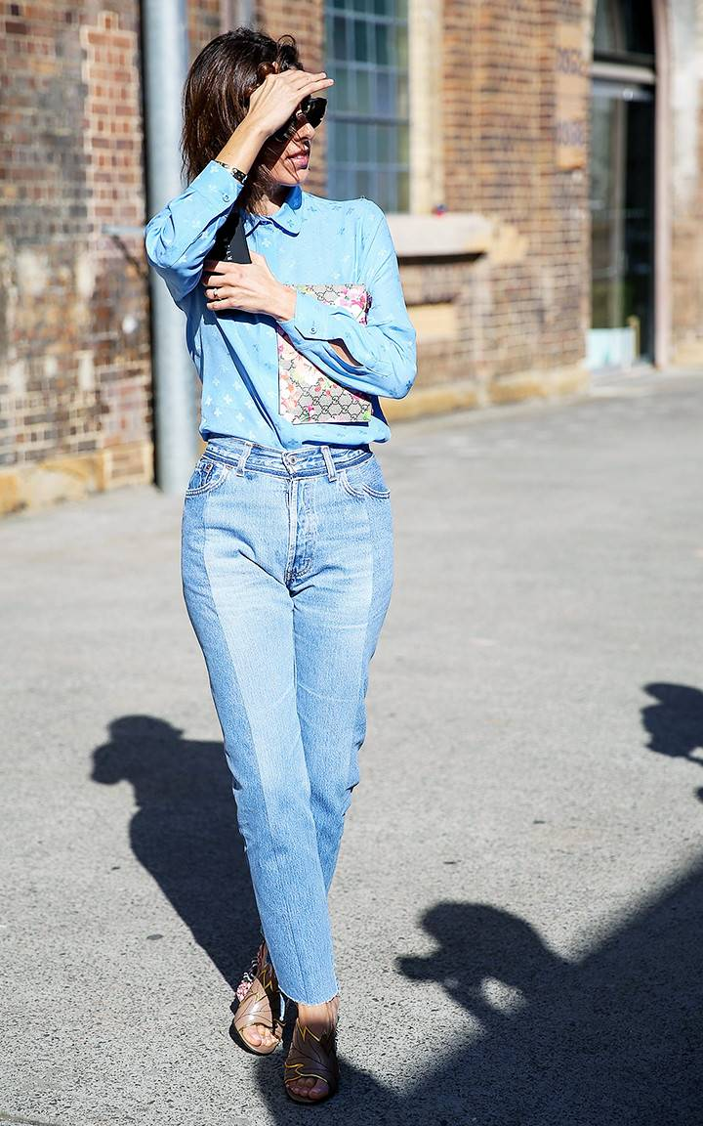
She is wearing blue jeans.
https://www.whowhatwear.co.uk/how-to-wear-high-waisted-jeans/slide2

Slide 2
Present Continuous
действие совершается, ситуация развивается;
подчеркивается незавершенный, длительный (длящийся) или временный характер действия;
запланированное будущее (Я собираюсь, ...)
Now, these days, at the moment…

Slide 3
Present Continuous
am / Is /are | + verb+ing
-e – опускается: ударный слог с кратким гласным между двумя согласными – удваивается: -l – удваивается: -ie – опускается и добавляется y+ing: | to write – writing to sit – sitting; to swim – swimming (но! opening) to travel – travelling to lie – lying, to die – dying

Slide 4
Present Continuous
I am cleaning the room now.
We are cleaning the room now.
You are cleaning the room now.
He is cleaning the room now.
She is cleaning the room now.
It is cleaning the room now.
They are cleaning the room now.

Slide 5
Present Continuous
I am not cleaning the room now.
We are not cleaning the room now.
You are not cleaning the room now.
He is not cleaning the room now.
She is not cleaning the room now.
It is not cleaning the room now.
They are not cleaning the room now.

Slide 6
Present Continuous
Am I cleaning the room now? Yes, I am. No, I am not.
Are we cleaning the room now? Yes, we are. No, we aren’t.
Are you cleaning the room now? Yes, you are/I am. No, you aren’t/I am not.
Is he cleaning the room now? Yes, he is. No, he isn’t.
Is she cleaning the room now? Yes, she is. No, she isn’t.
Is it cleaning the room now? Yes, it is. No, it isn’t.
Are they cleaning the room now? Yes, they are. No, they aren’t.

Slide 7
Present Continuous
What are you cleaning now?
Вопрос к подлежащему
Who is cleaning the room? – They are.

Slide 10
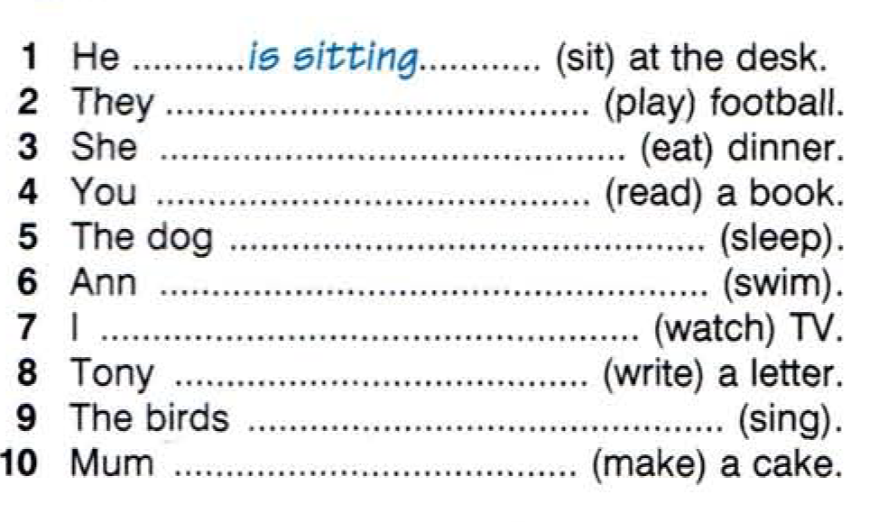

Slide 11
